Slide 1
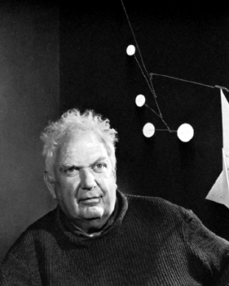
Alexander Calder
1898 - 1976
MOBILES
STABILES
PAINTINGS

Slide 2
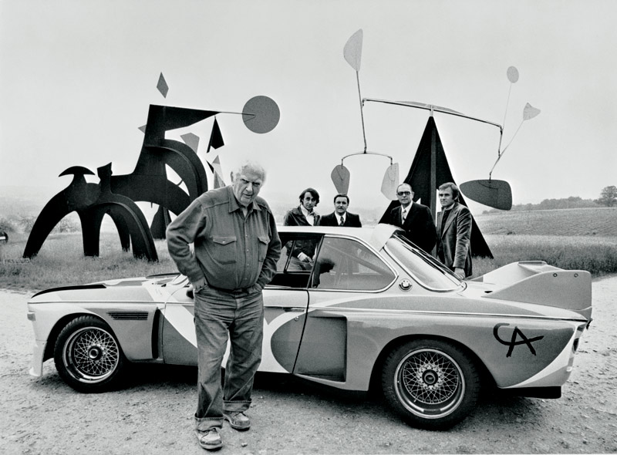

Slide 3
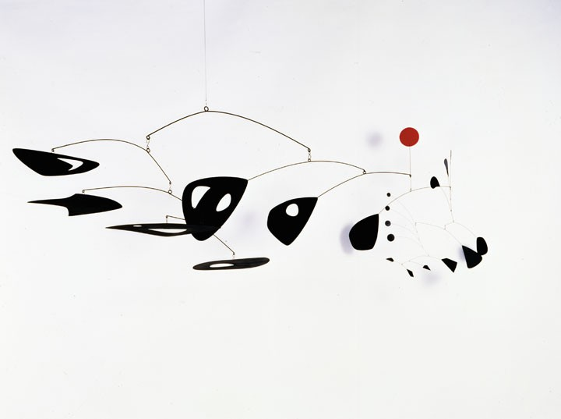
MOBILES:
a type of moving sculptural artwork developed by Alexander Calder in 1932 and named by Marcel Duchamp. Often constructed of colored metal pieces connected by wires or rods, the mobile has moving parts that are sensitive to a breeze or light touch; it can be designed to hang from the ceiling or stand free on the floor. Mobiles became popular in the 1950s for interior decoration.

Slide 4
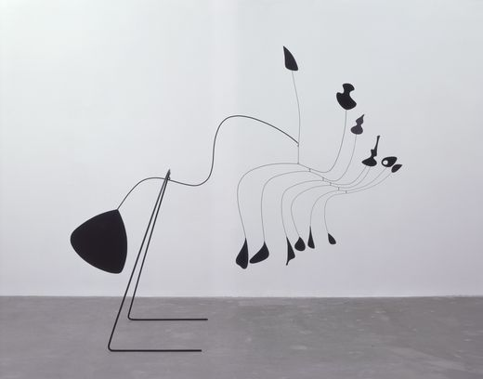
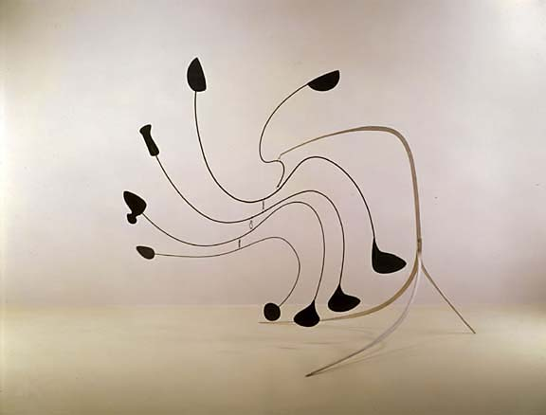

Slide 5
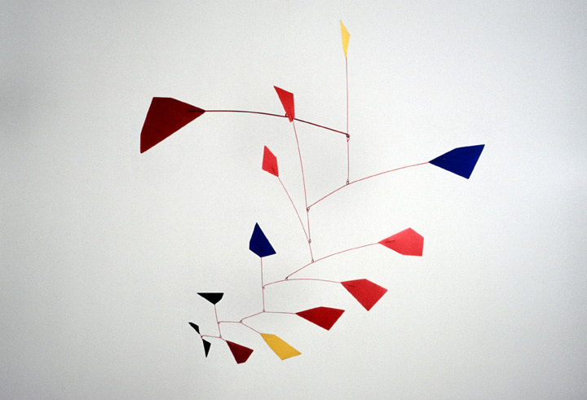

Slide 6
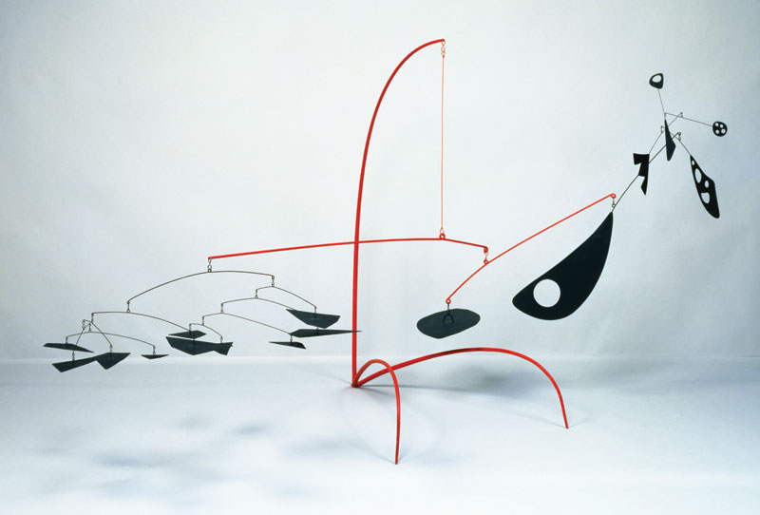

Slide 7
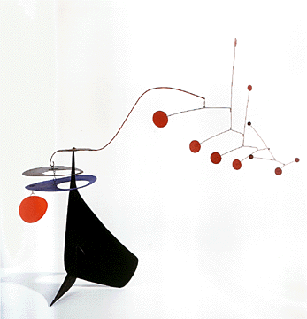

Slide 8
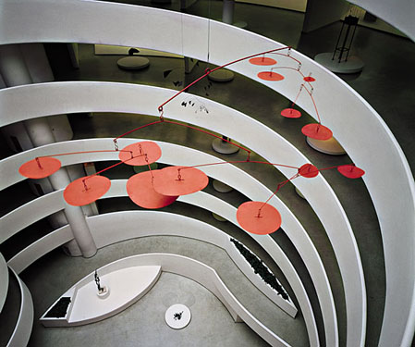

Slide 9
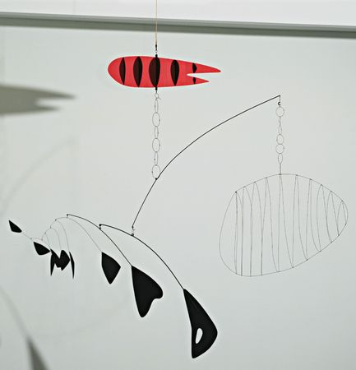

Slide 11
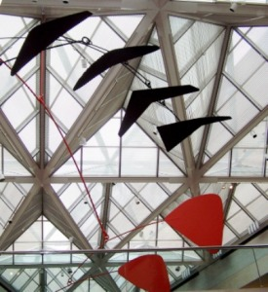
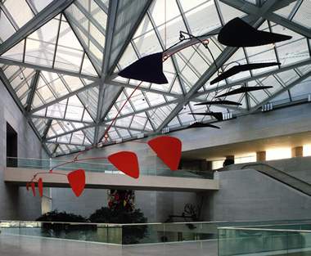

Slide 12
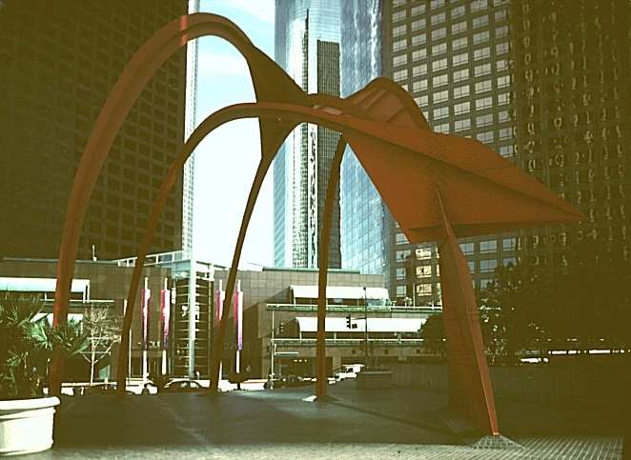
STABILES:
an abstract construction that is completely stationary.
Four Arches
Alexander Calder 1975 painted steel, 63'H

Slide 13
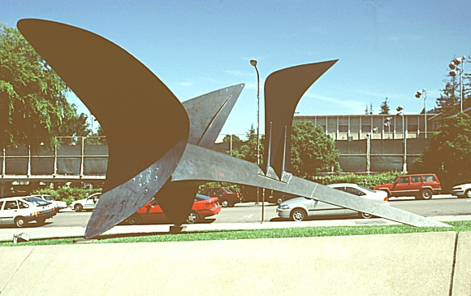
The Hawk for Peace, University of California at Berkeley Art Museum
Alexander Calder 1968

Slide 14
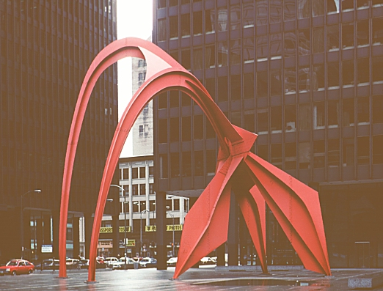
Flamingo, Federal Center Plaza
53 feet high Alexander Calder 1974

Slide 15
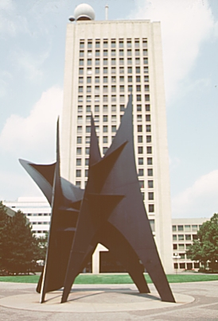
Big Sail, MIT campus
40 feet high Alexander Calder 1966

Slide 16
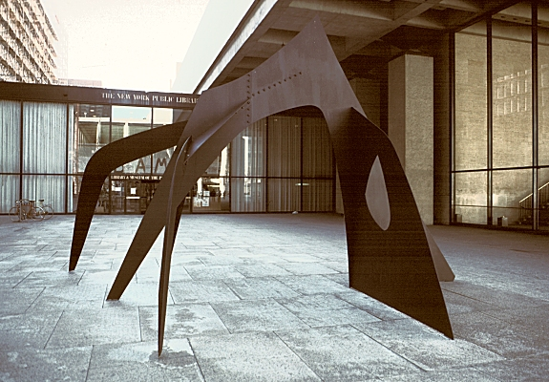
Le Guichet, Lincoln Center for the Performing Arts
painted steel plate, 22 feet high Alexander Calder 1963

Slide 17
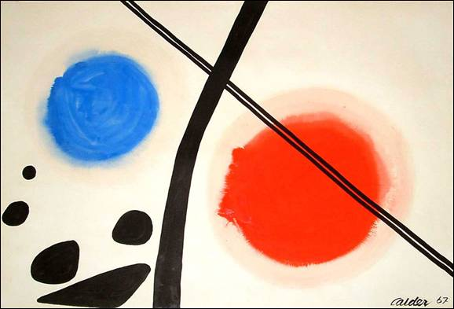
PAINTINGS

Slide 18
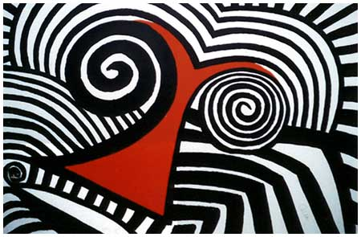

Slide 19
